Slide 1

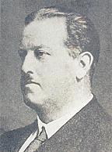



Pollen databases:
from von Post to Neotoma
Eric C. Grimm
University of Minnesota
Geoinformatics Program

Slide 2
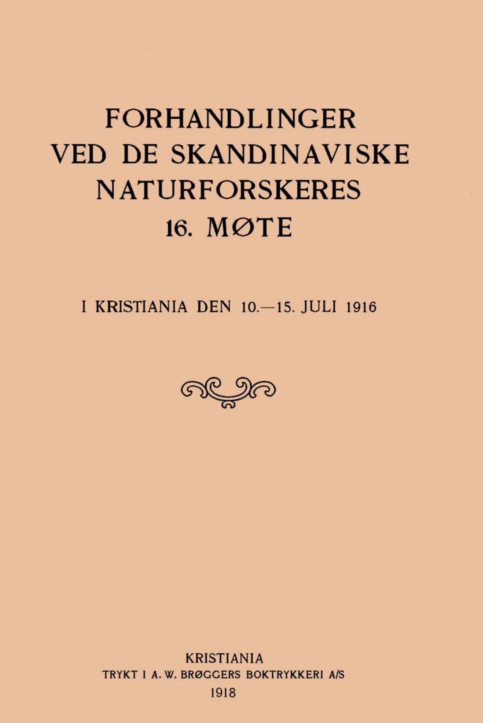
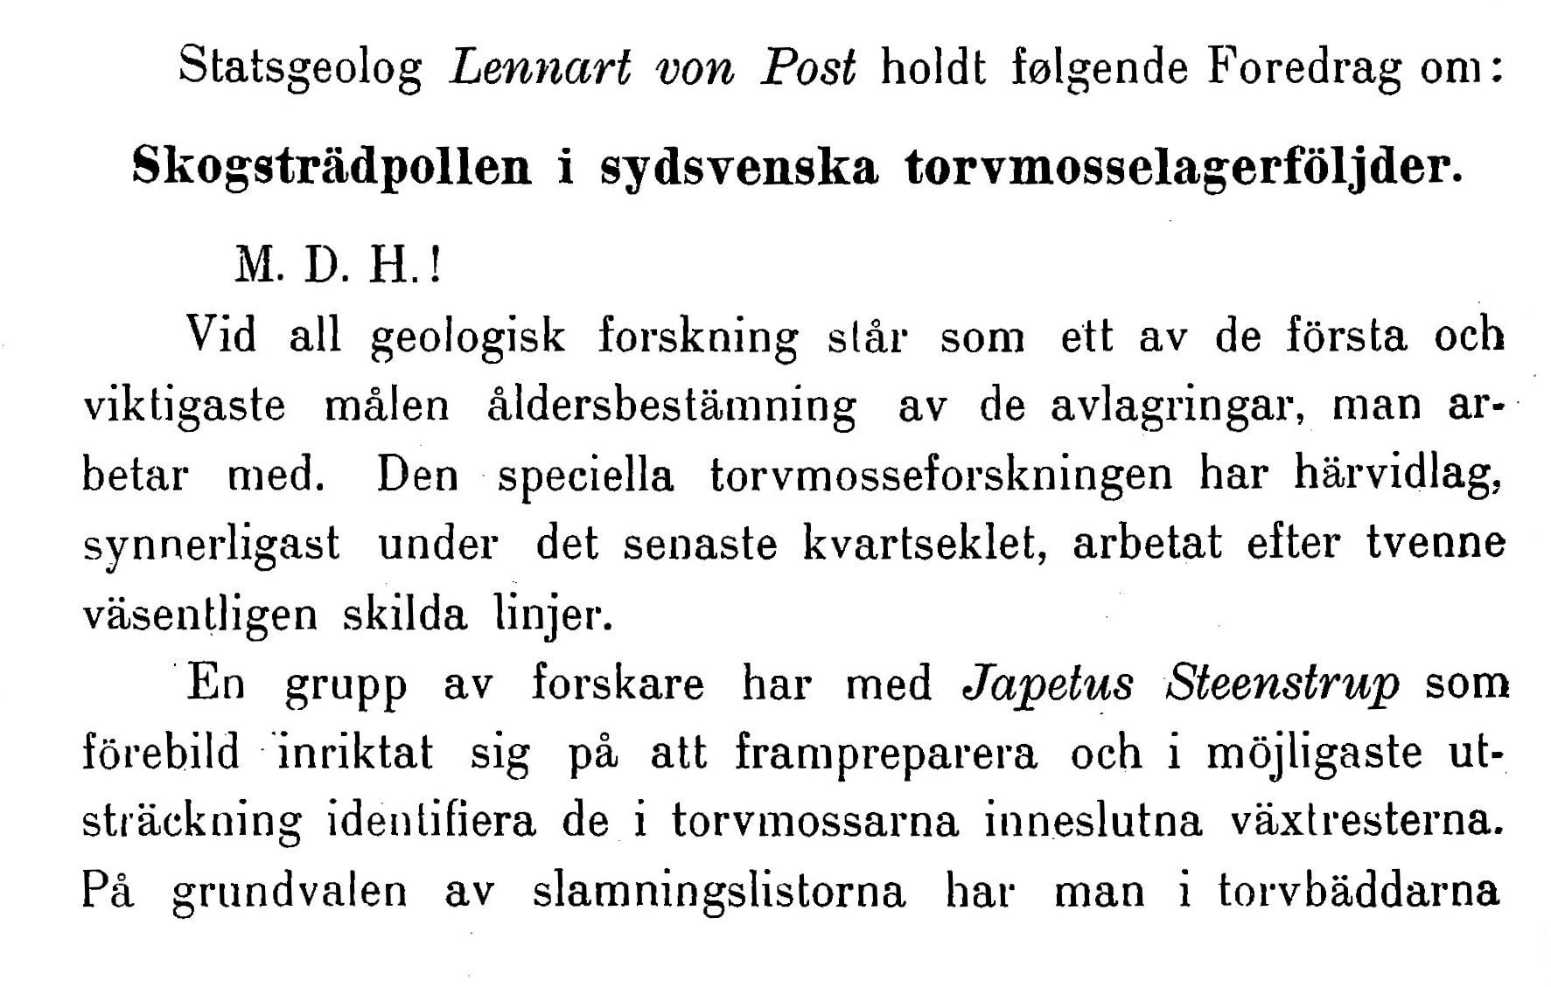
State Geologist Lennart von Post presented the following lecture:
Forest tree pollen in south Swedish peat bog sediments.
von Post, L. 1918. Skogssträdpollen i sydsvenska torvmosselagerföljder. Forhandlinger ved de Skandinaviske Naturforskeres 16. Møte. I Kristiana den 10-15 Juli 1916, pp. 432-468. A. W. Brøggers Boktrykkeri A/S, Kristiania [Oslo], Norway.

Slide 3
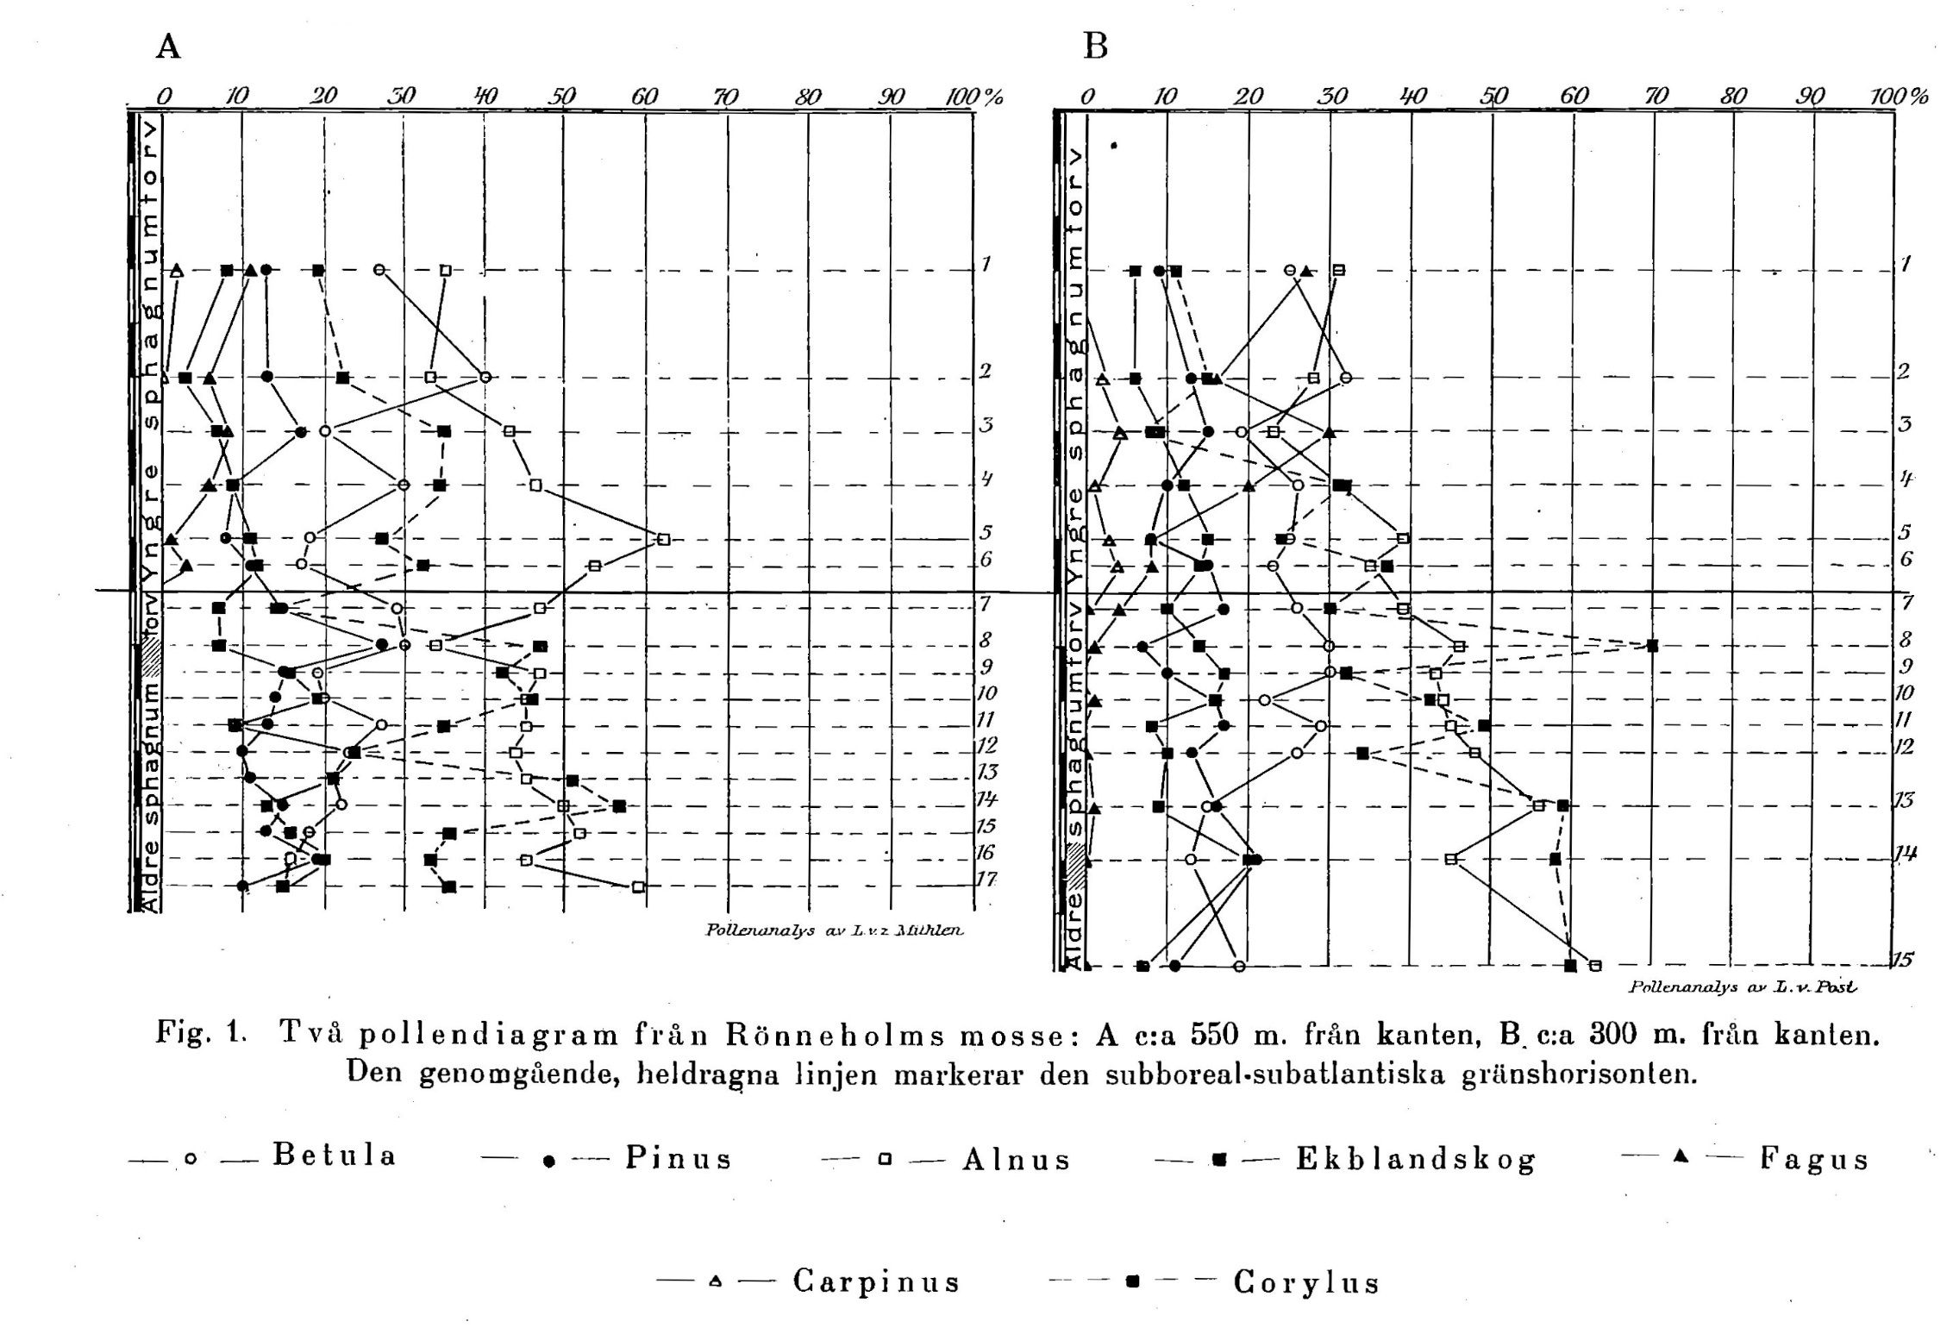
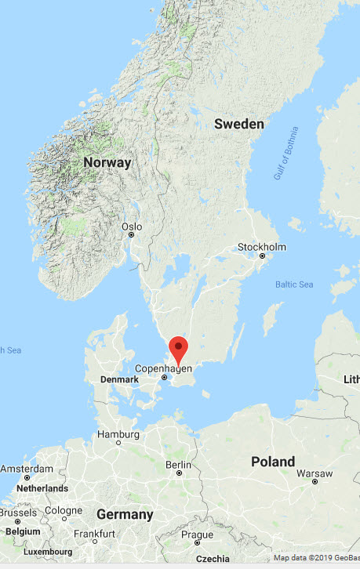
von Post 1916-1918, Figure 1. Pollen diagrams from Rönneholms mosse

Slide 4
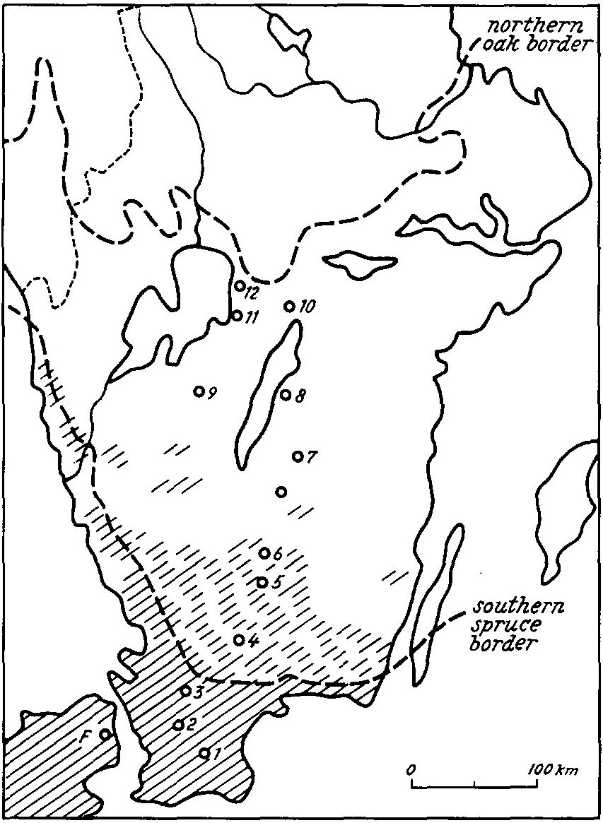
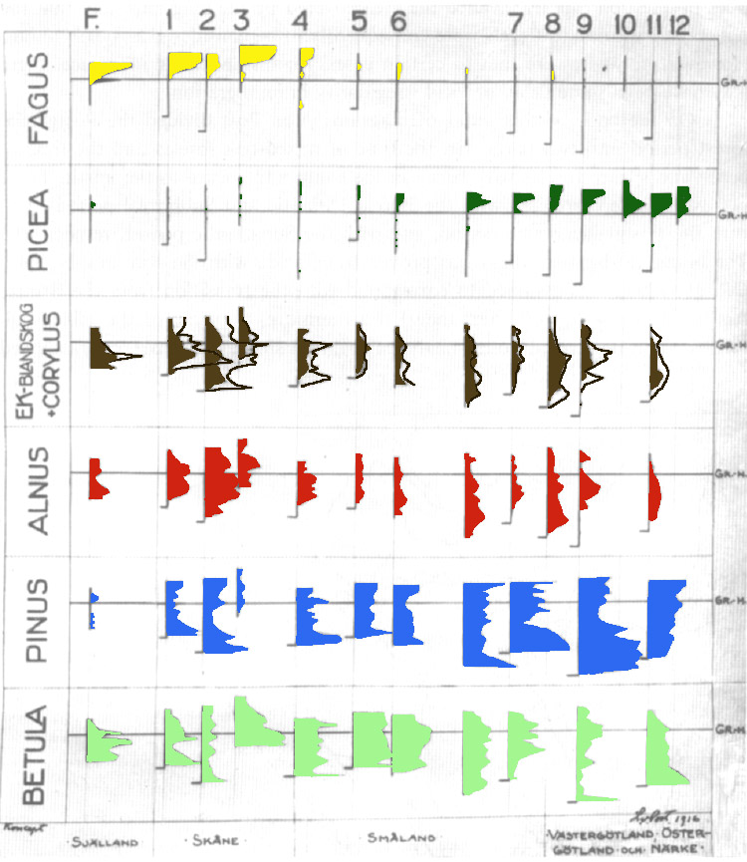

Slide 5

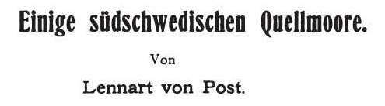

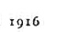
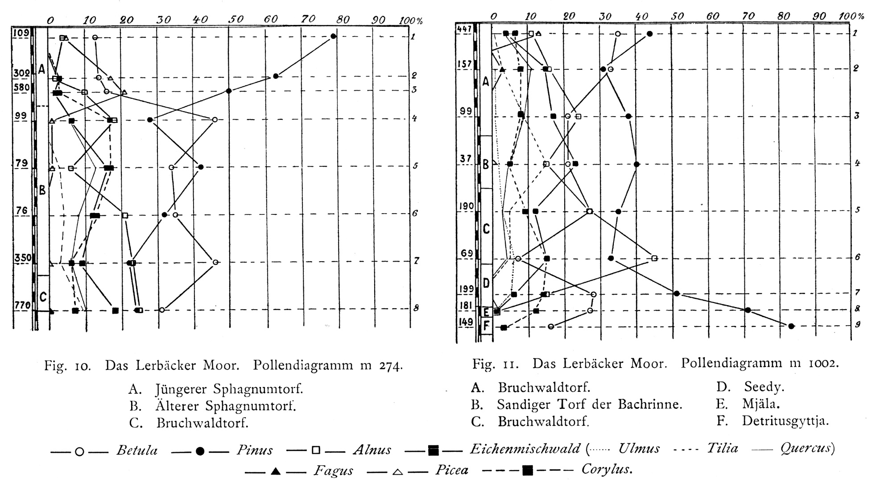
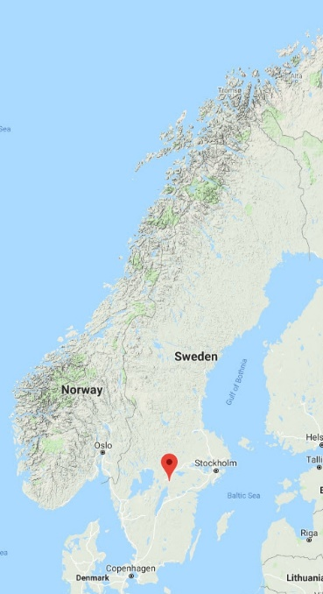
Das Lerbäcker Moor. The very first pollen diagrams published

Slide 6
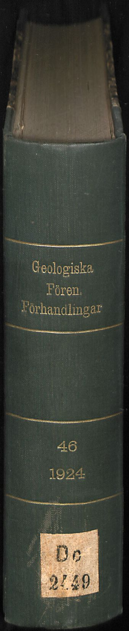
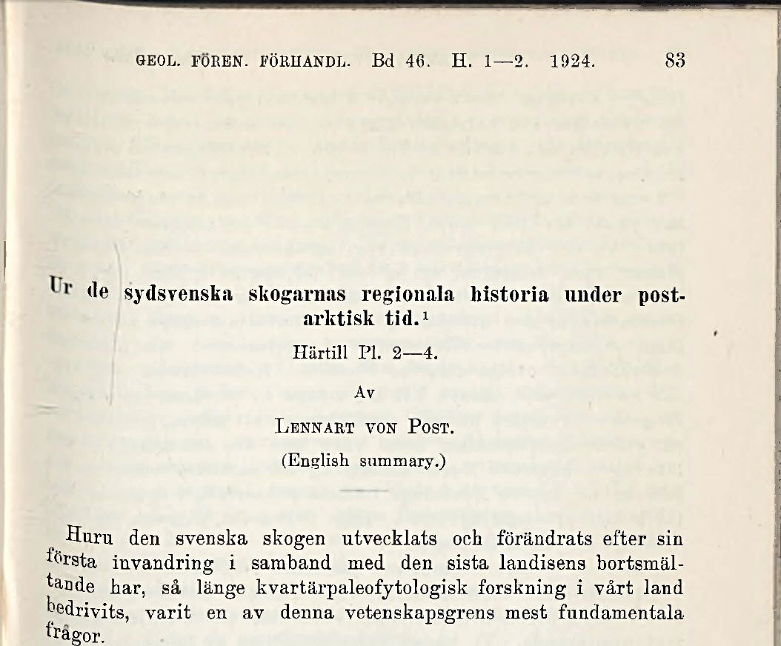
Von Post, L. 1924. Ur de sydsvenska skogarnas regional historia under post-arktisk tid. Geologiska Föreningens Förhandlingar 46(1-2):83–128
Some features of the regional history of the forests of southern Sweden in post-arctic time.

Slide 7
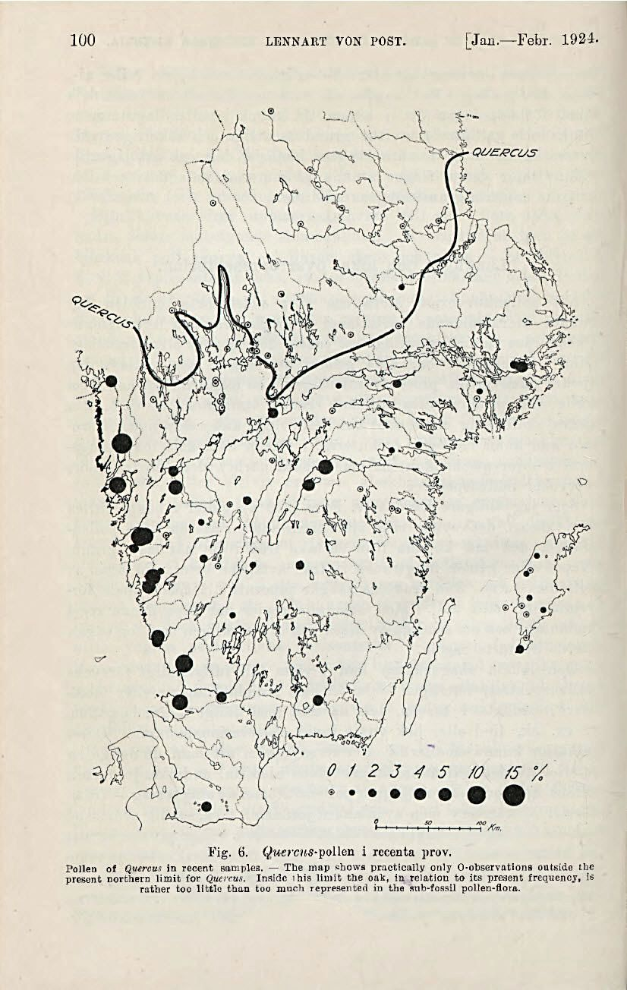
Surface Samples!
Fig. 6. Quercus-pollen in recenta prov.
Pollen of Quercus in recent samples. — The map shows practically only 0-observations outside the present northern limit for Quercus. Inside this limit the oak, in relation to its present frequency, is rather too little than too much represented in the sub-fossil pollen-flora.

Slide 8
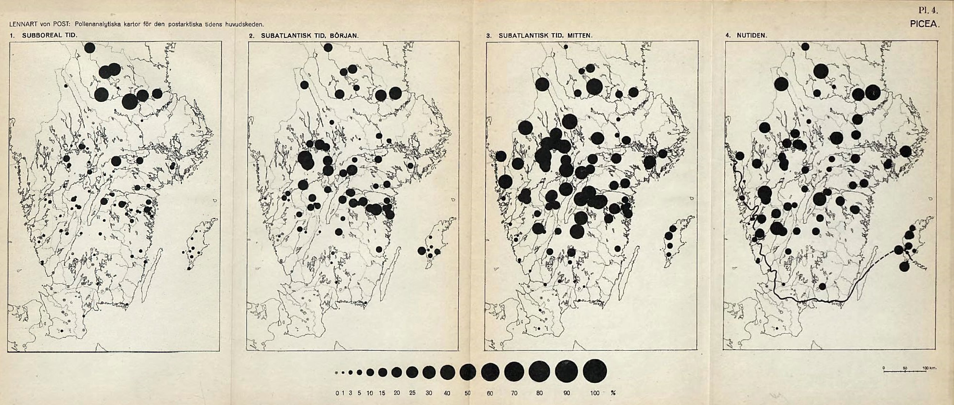
Picea
Subboreal
Early Subatlantic
MIddle Subatlantic
Recent
For von Post to make his diagrams, he had to assemble, organize, extract, and process data in some way. In other words, he had to create a “database”, although that term had not been invented yet.

Slide 9
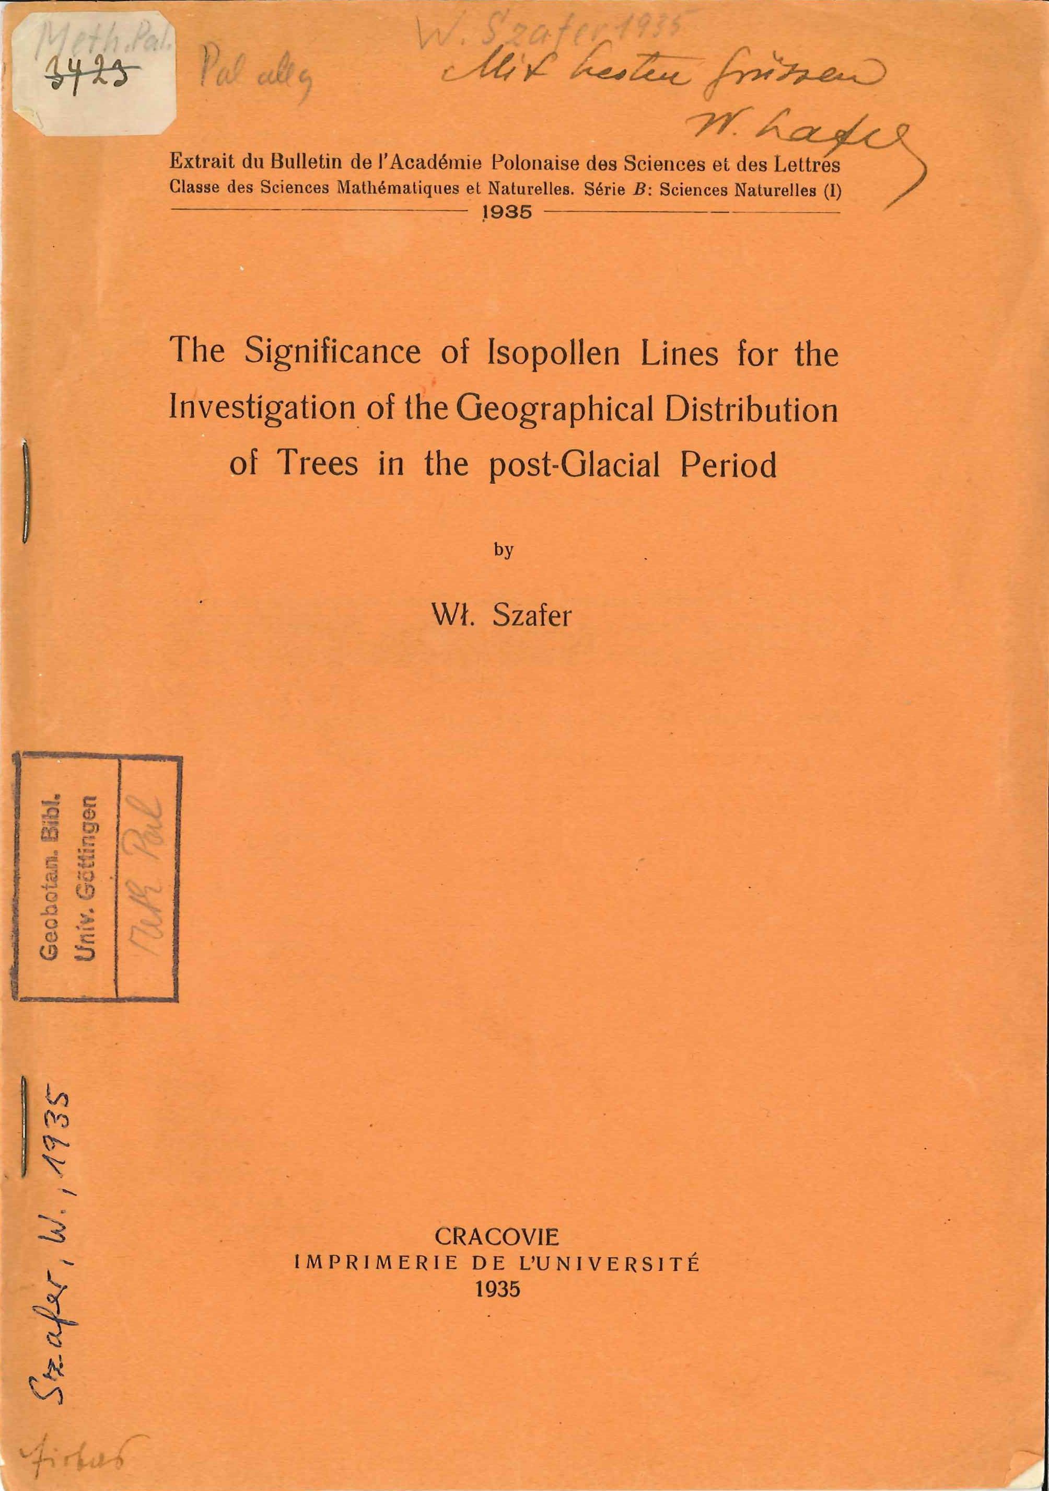
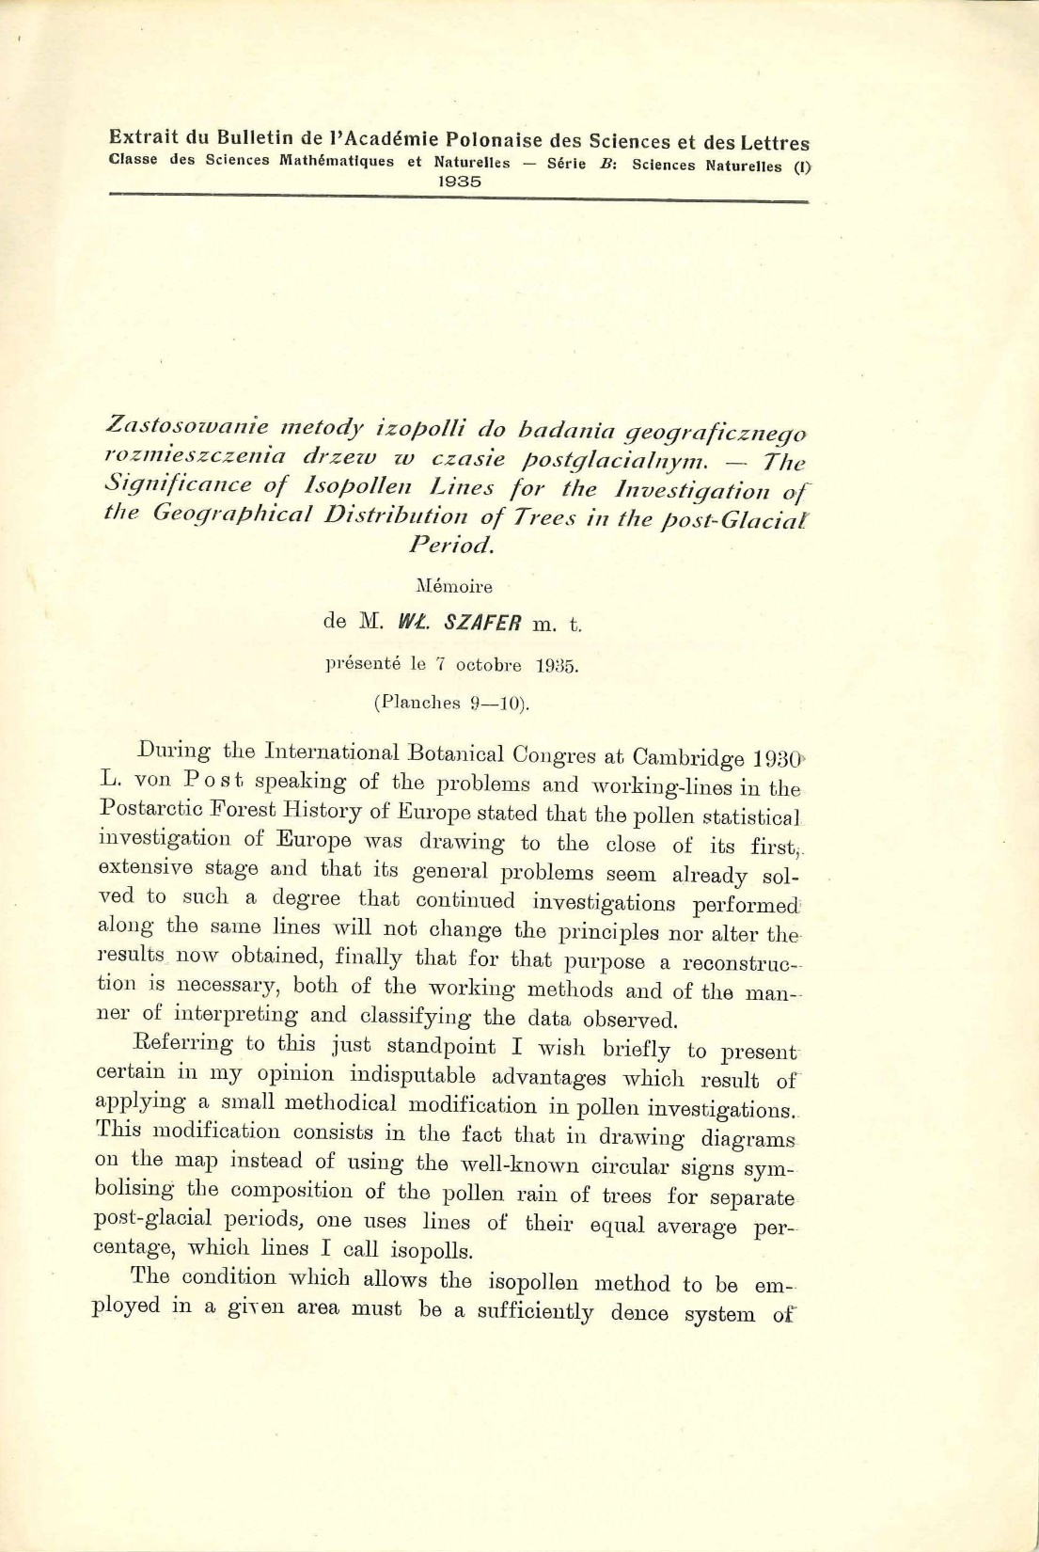
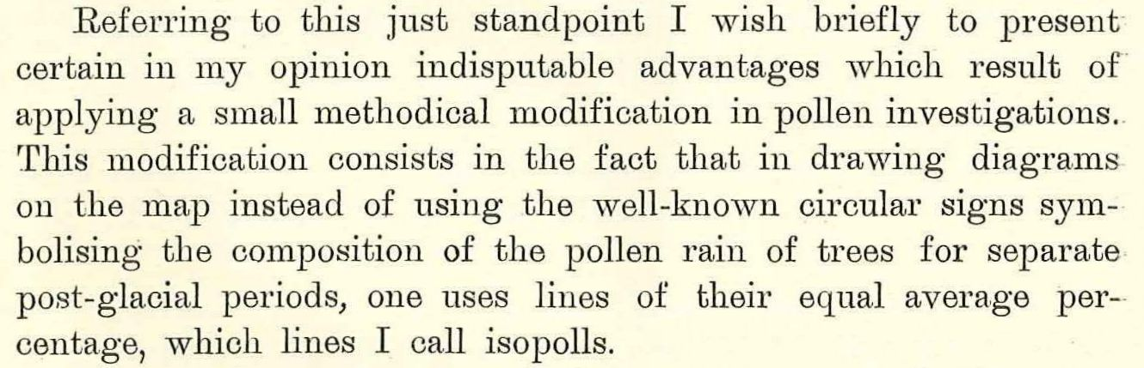
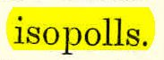
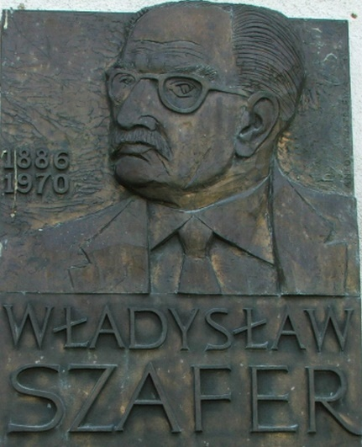

Slide 10
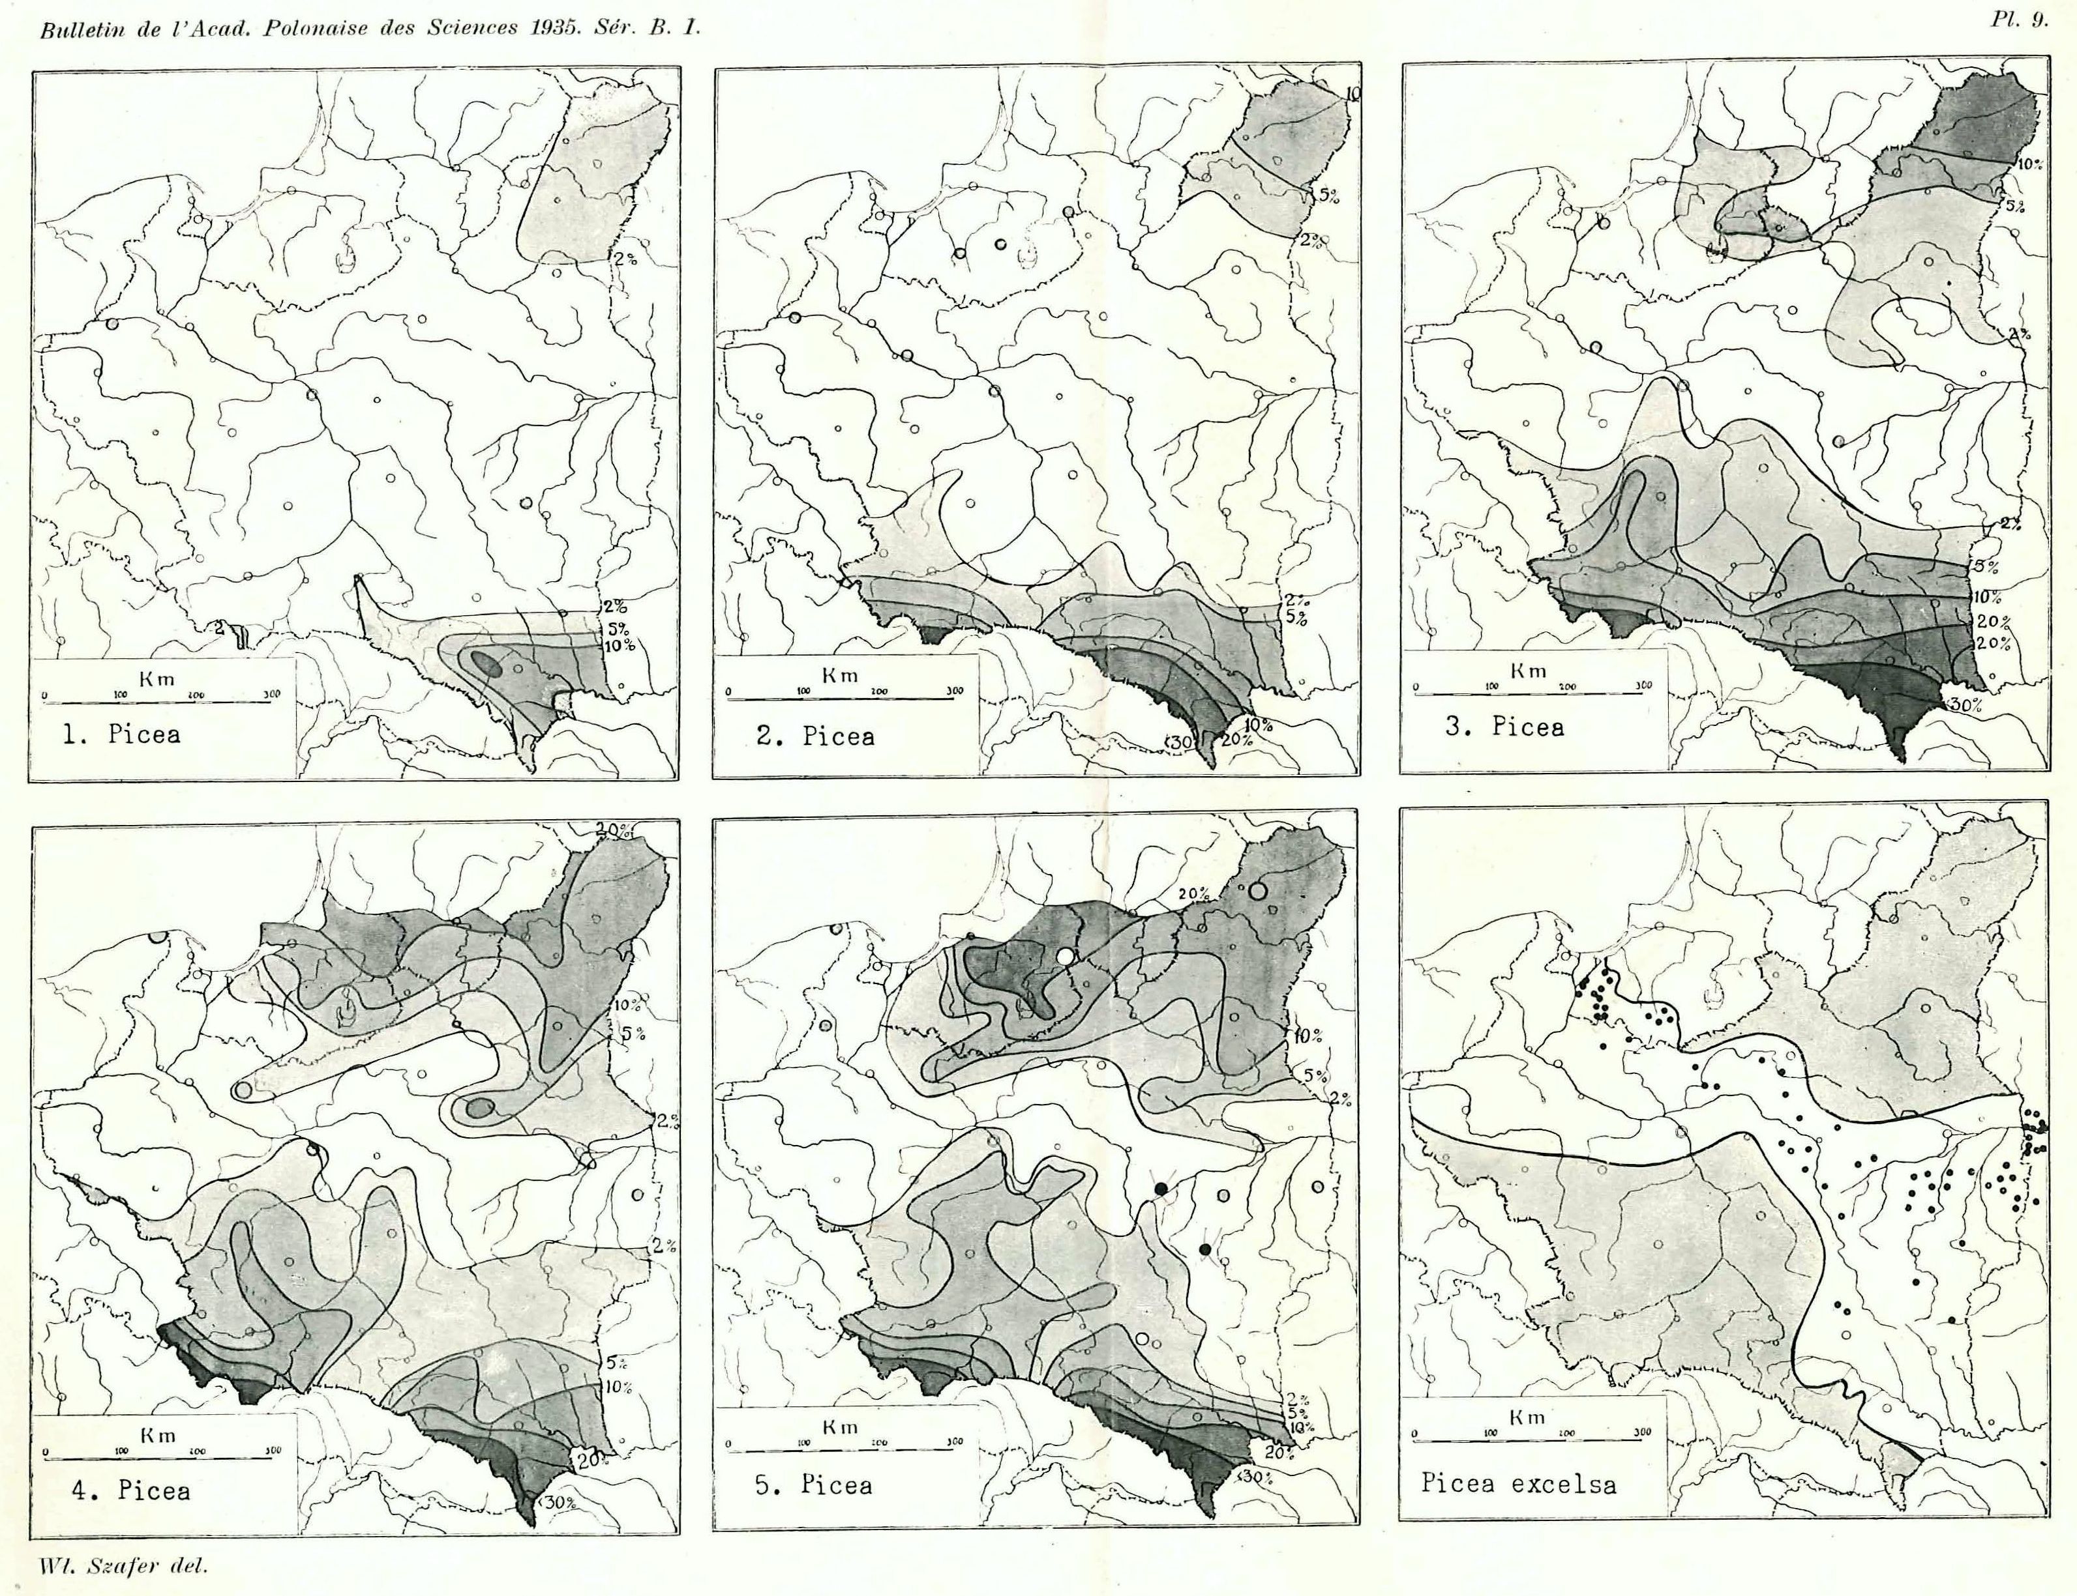
Szafer, 1935
Picea
1. Subarctic period, domination of pine and birch (Allerød/Younger Dryas)
2. Approach of the warm period, first increase in warmth-requiring trees (Preboreal and Boreal)
3. Culmination of warmth-requiring trees (Atlantic)
4. Period of decrease of warm-requiring trees, increase in sub-atlantic trees beech and fir (Subboreal)
5. Increase of sub-continental forest elemsnts like spruce (Subatlantic)

Slide 11
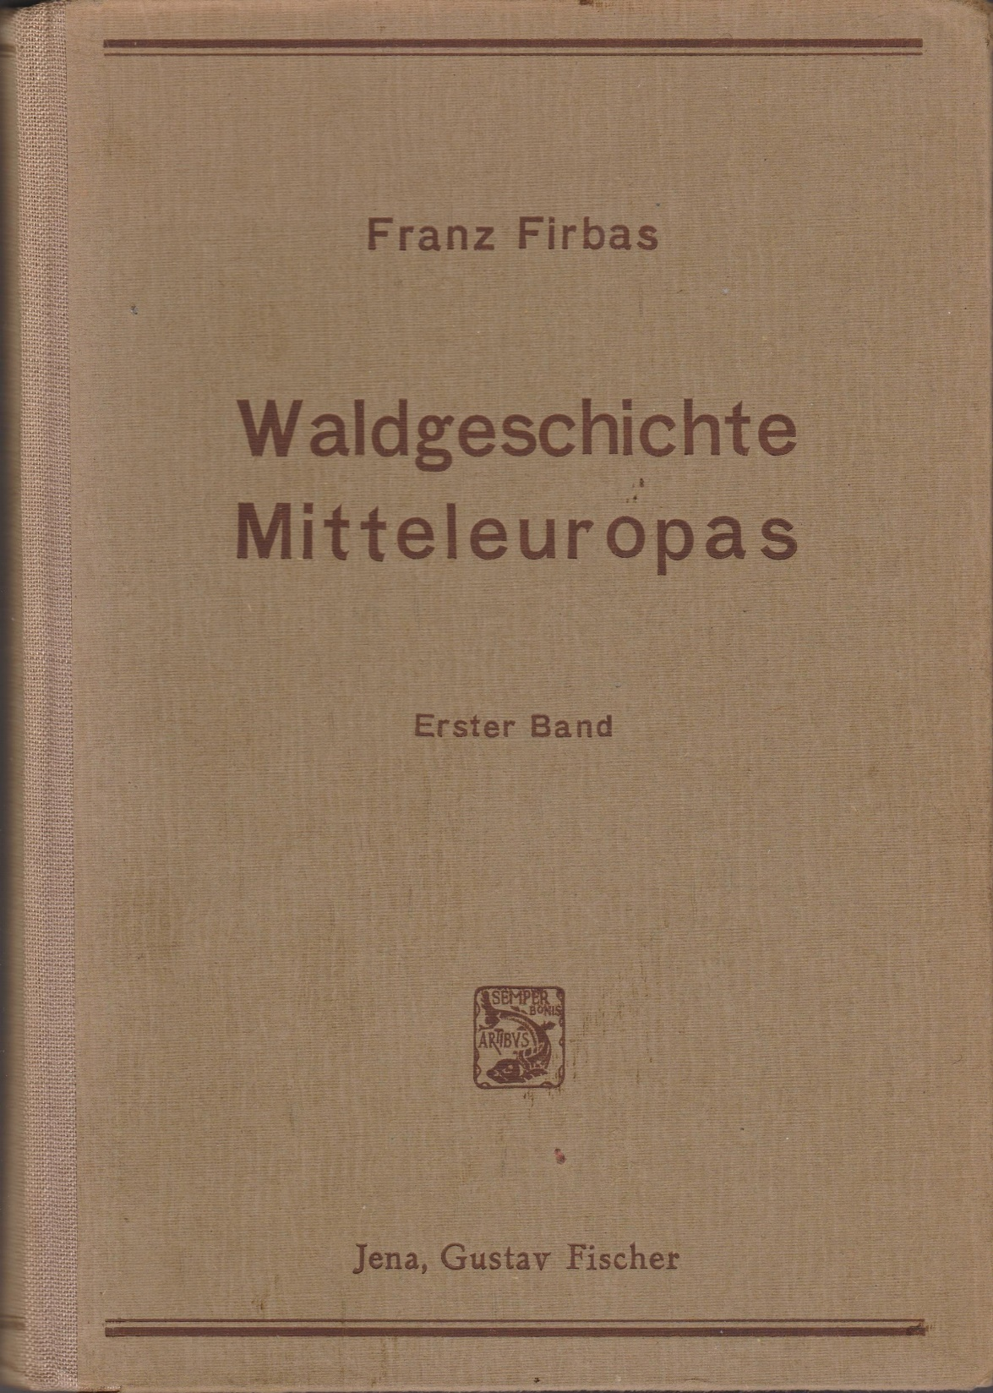
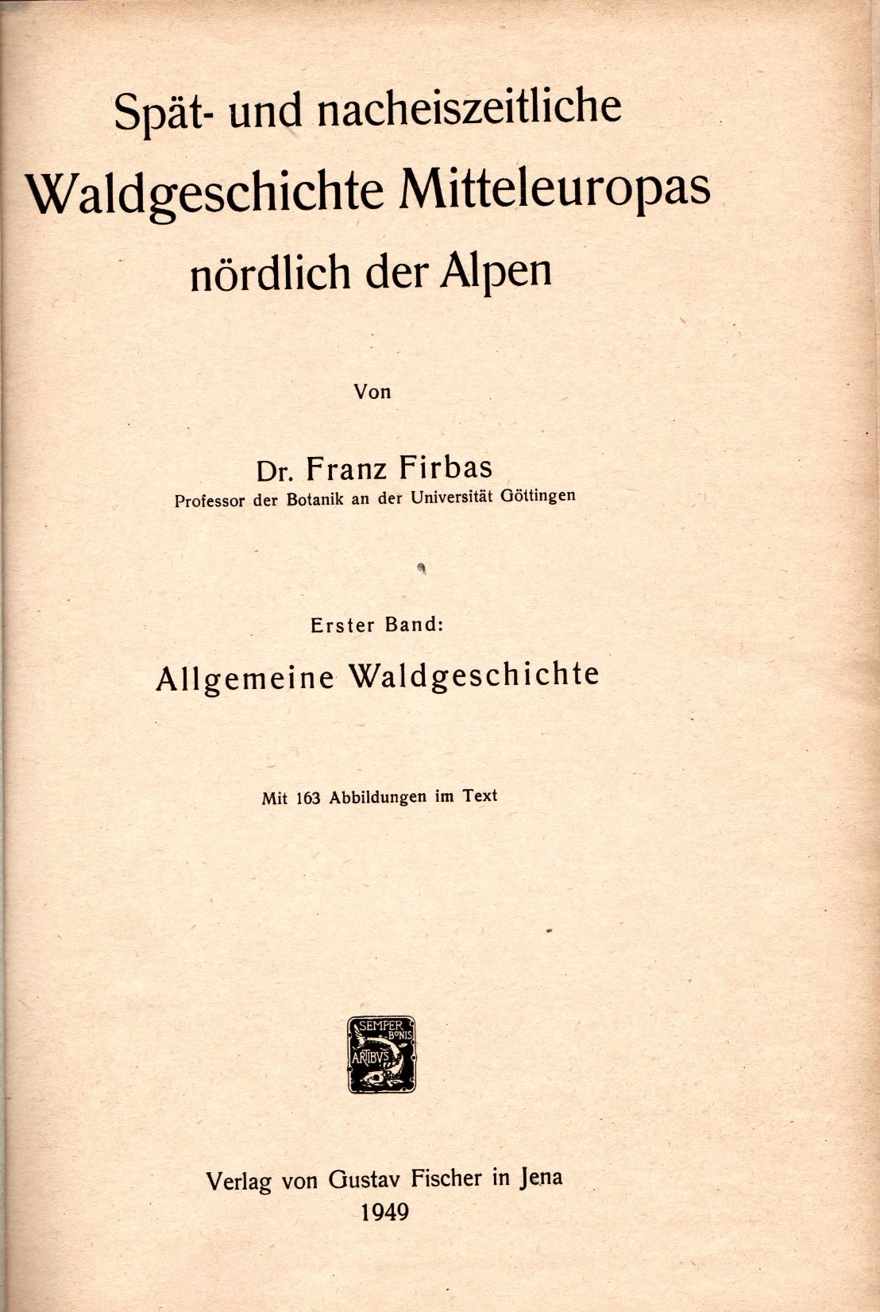
Late- and postglacial forest history of Middle Europe north of the Alps

Slide 12
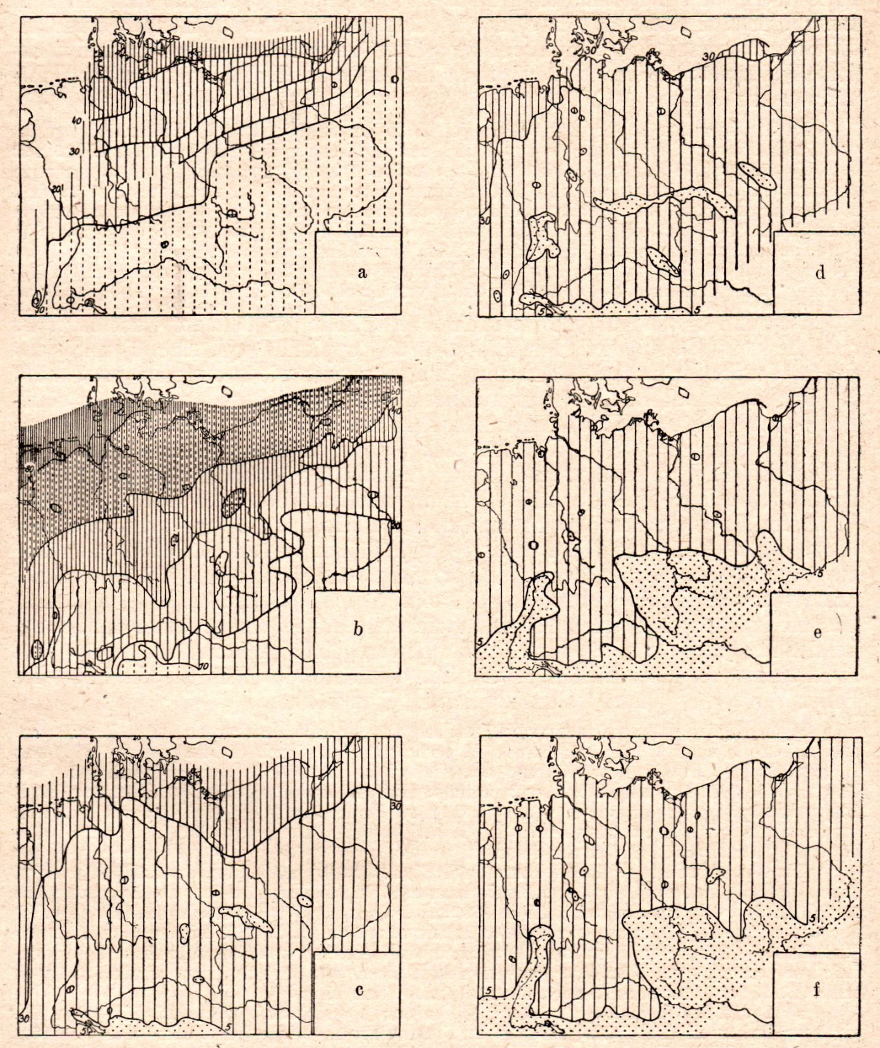
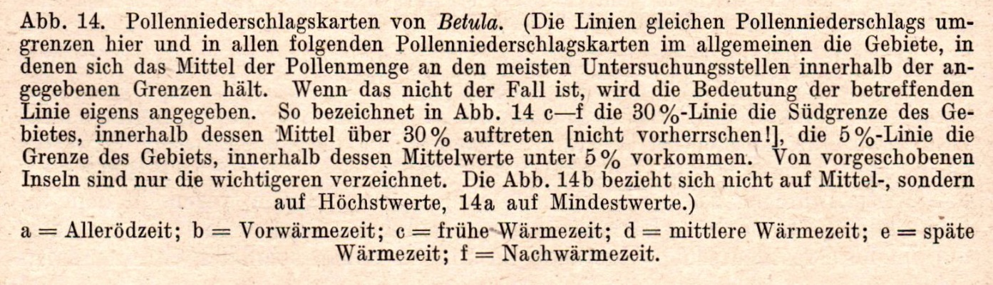
Firbas, 1949
Pollenniederschlagskarten
(pollen rain maps) von Betula
Allerød
Preboreal
Boreal
Atlantic
Subboreal
Subatlantic

Slide 13
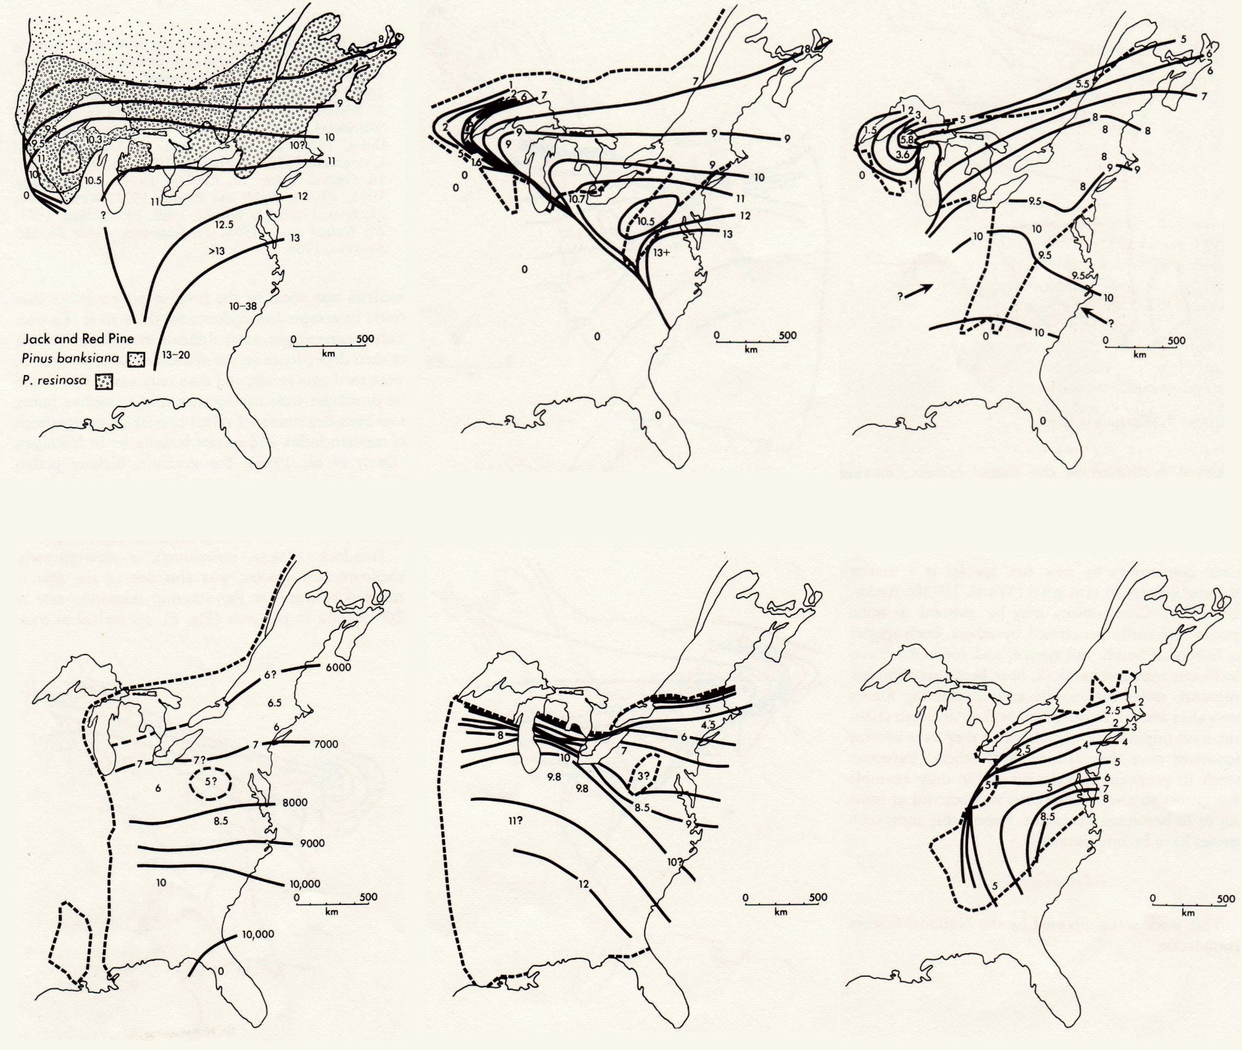
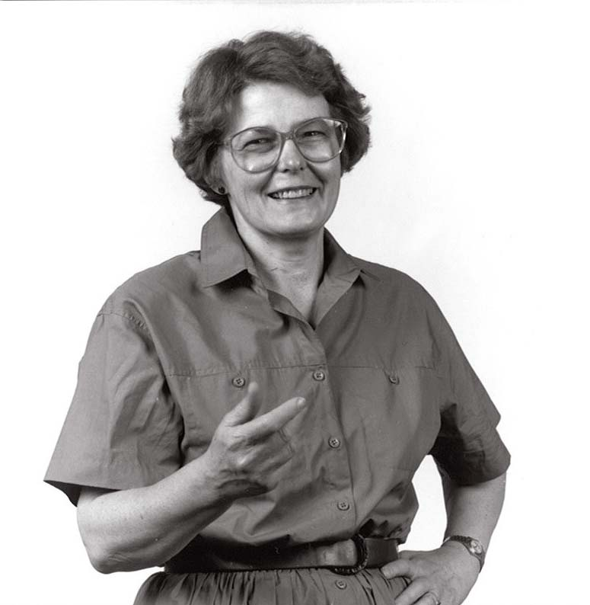
Davis, 1976
Isochrone or Migration Maps
Davis, M.B. 1976. Pleistocene biogeography of temperate deciduous forests. Geoscience and Man 13:15-26.
Pinus subg. Pinus
Pinus subg. Stobus
Tsuga
Fagus
Carya
Castanea

Slide 14
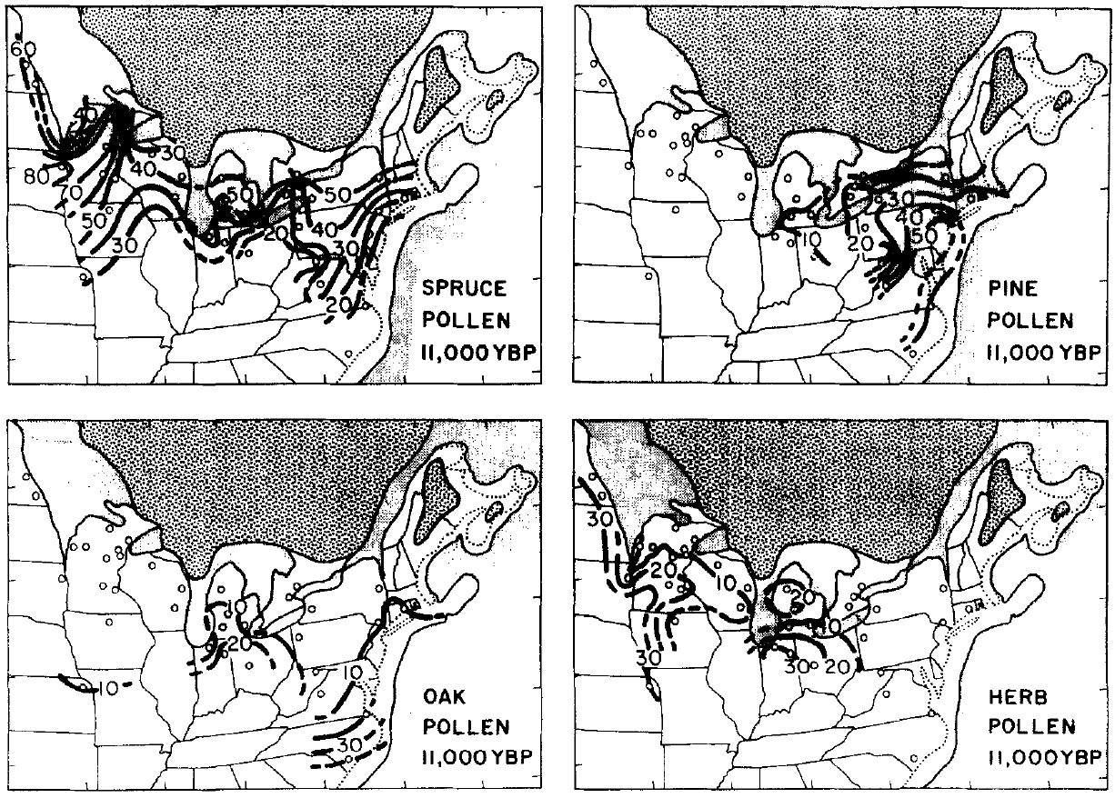

Bernabo and Webb, 1977
Isopoll Maps
This paper was a product of the COHMAP project. Initially, COHMAP stood for “Climates of the Holocene—Mapping Based on Pollen Data.” The project name was later changed to “Cooperative Holocene Mapping Project.”
COHMAP was a collaboration between climate modelers and paleoecologists, and a major COHMAP effort was validation or testing of climate models with paleoclimatic data.
COHMAP was a transformative project that applied paleoecology, previously a somewhat esoteric science, with quantitative methods to the crucial problem of understanding global climate change.
Under the direction of Thompson Webb III, COHMAP assembled the first large-scale computer database of pollen-count data.
Bernabo, J.C., and T. Webb III. 1977. Changing patterns in the Holocene pollen record of northeastern North America: a mapped summary. Quaternary Research 8(1):64-96.

Slide 15
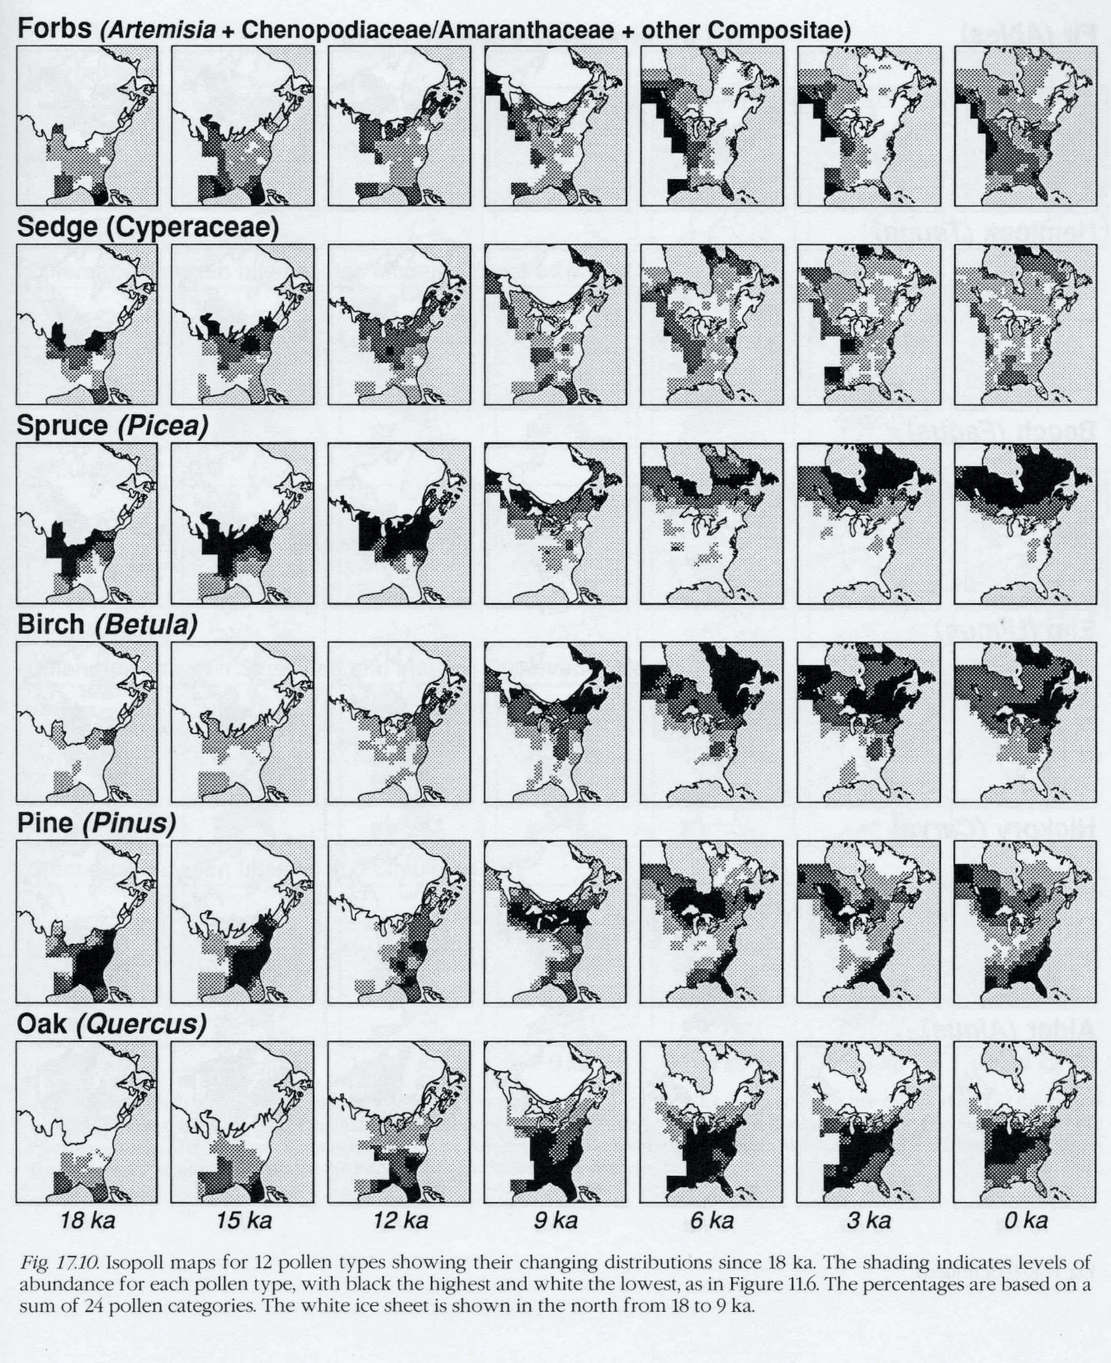
Gridded Isopoll maps
Webb, T., III, P.J. Bartlein, S.P. Harrison, and K.H. Anderson. Vegetation, lake levels, and climate in eastern North America for the past 18,000 years. COHMAP book, Chapter 17.

Slide 16
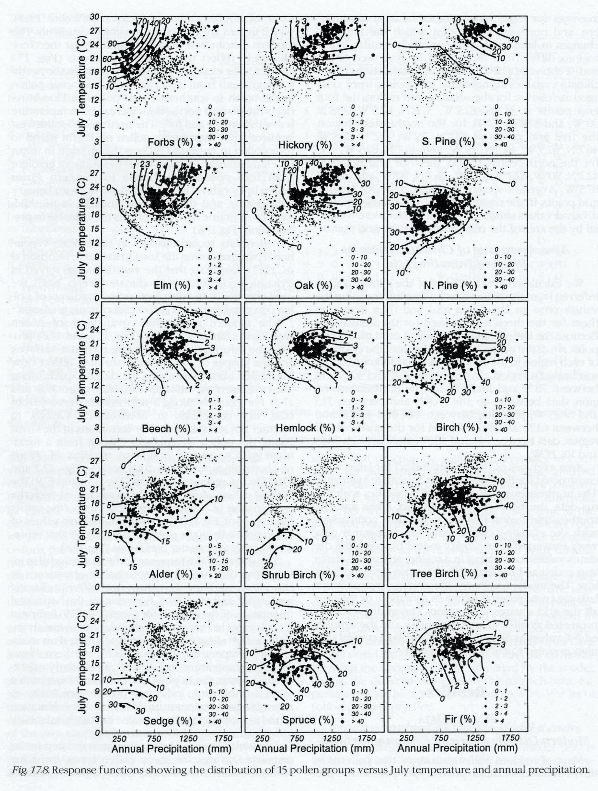
Pollen-Climate Response Surfaces
Webb, T., III, P.J. Bartlein, S.P. Harrison, and K.H. Anderson. Vegetation, lake levels, and climate in eastern North America for the past 18,000 years. COHMAP book, Chapter 17.

Slide 17
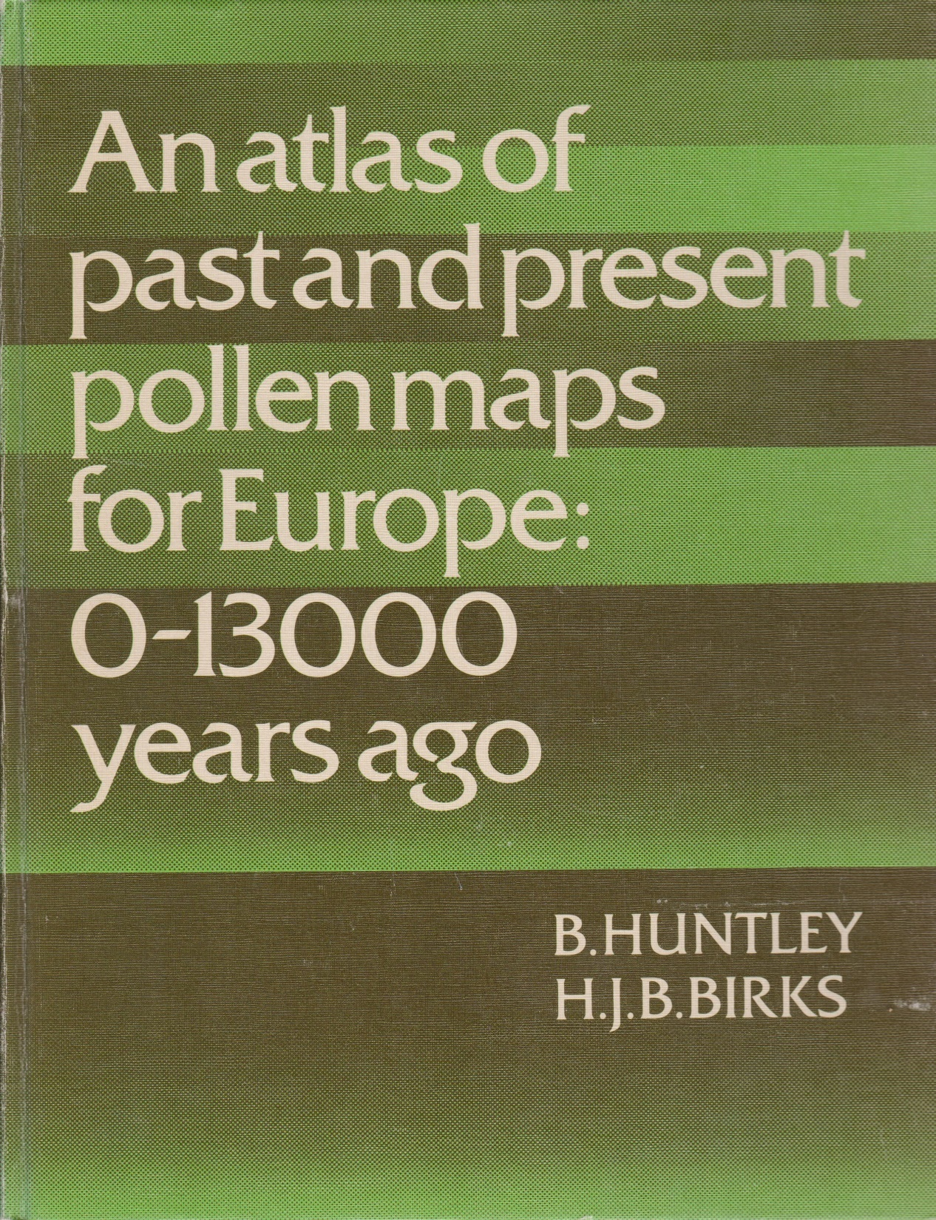

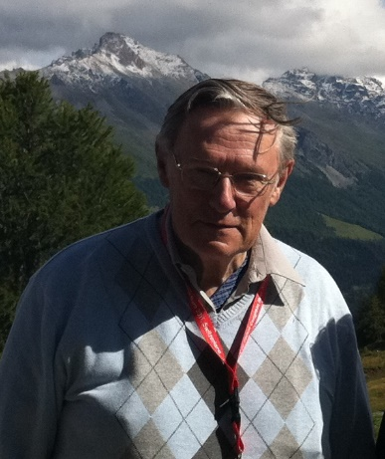
Huntley, B., and H.J.B. Birks. 1983. An atlas of past and present pollen maps for Europe: 0–13000 years ago. Cambridge University Press, Cambridge, United Kingdom
Isopoll maps at 500 yr intervals for Europe.
46 taxa mapped.
423 core localities, 420 surface-sample localities
Based mainly on published pollen diagrams.
Flat-file database. Manipulated with FORTRAN IV programs.
Initial maps drawn by computer. Final isopoll maps hand contoured.

Slide 18
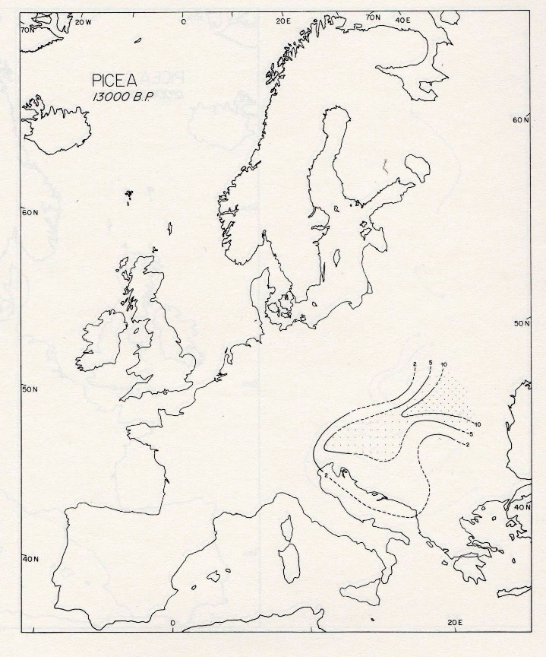
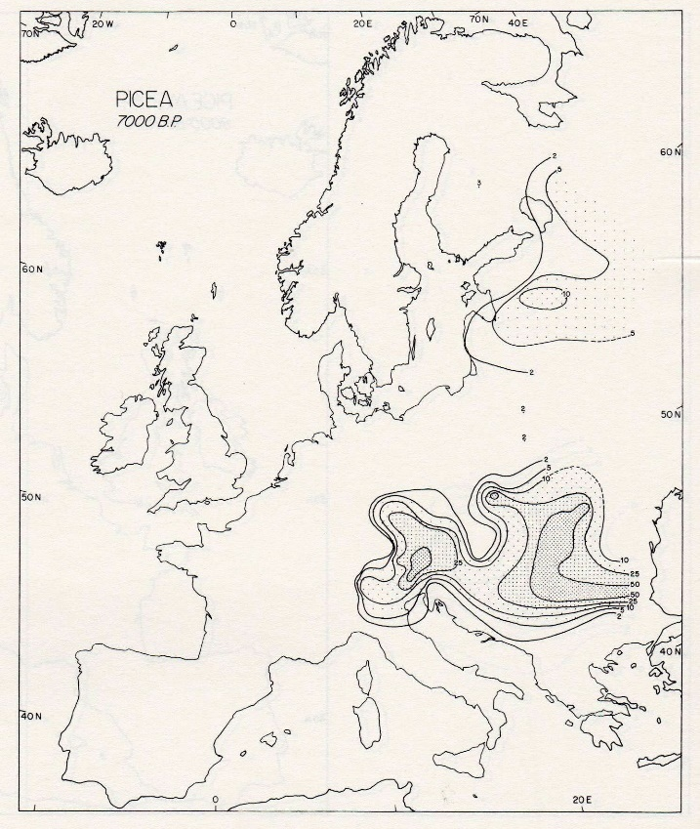
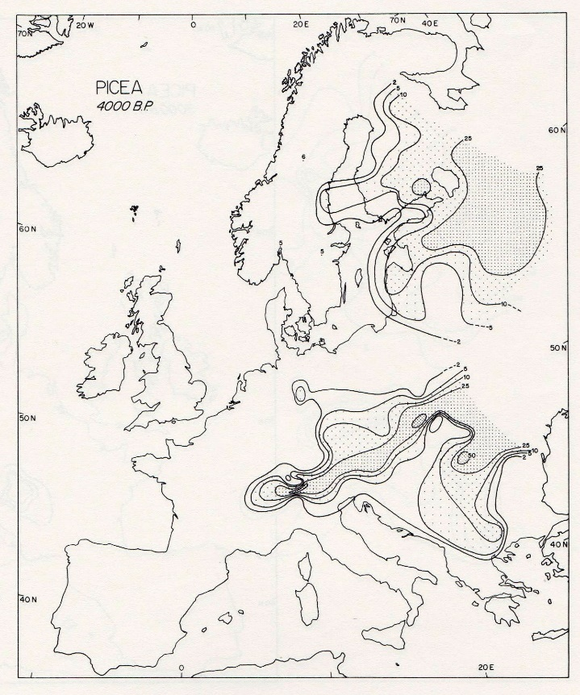
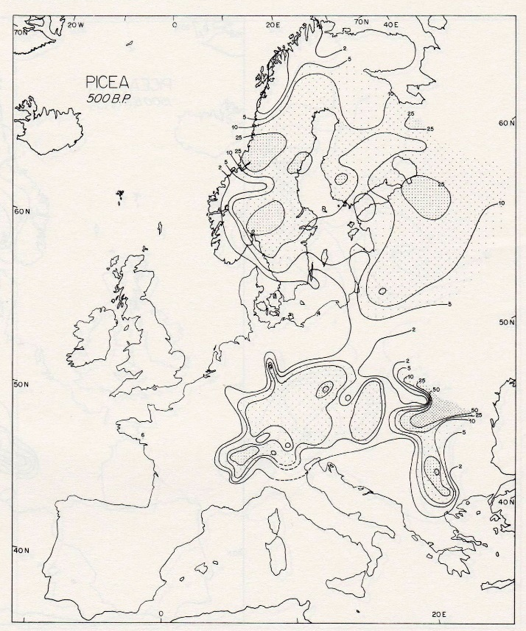
Picea
13000 BP
7000 BP
4000 BP
500 BP
Huntley and Birks, 1983

Slide 19
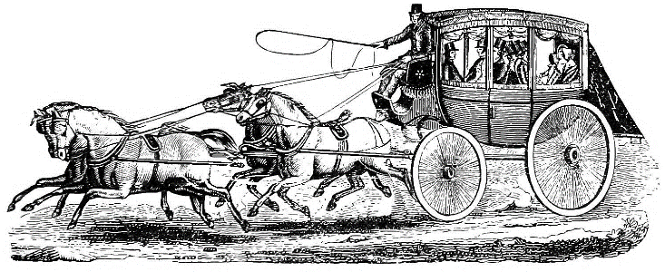

By the late 1980s:
Research groups such as COHMAP had assembled large quantities of data, the management of which was becoming onerous.
The great scientific value of large pollen databases had been established.
Contributors to databases also wanted access to them.
The COHMAP project was winding down, and the disposition of the COHMAP pollen database was a concern.
Relational Database Management Systems (RDBMS’s) had been developed to the point where we could contemplate deploying them for pollen data.
Personal computers were becoming widely available, and, importantly, RDBMS’s were available for the PC (Ingres, dBase, Paradox).
Which set the stage for implementing pollen databases!

Slide 20
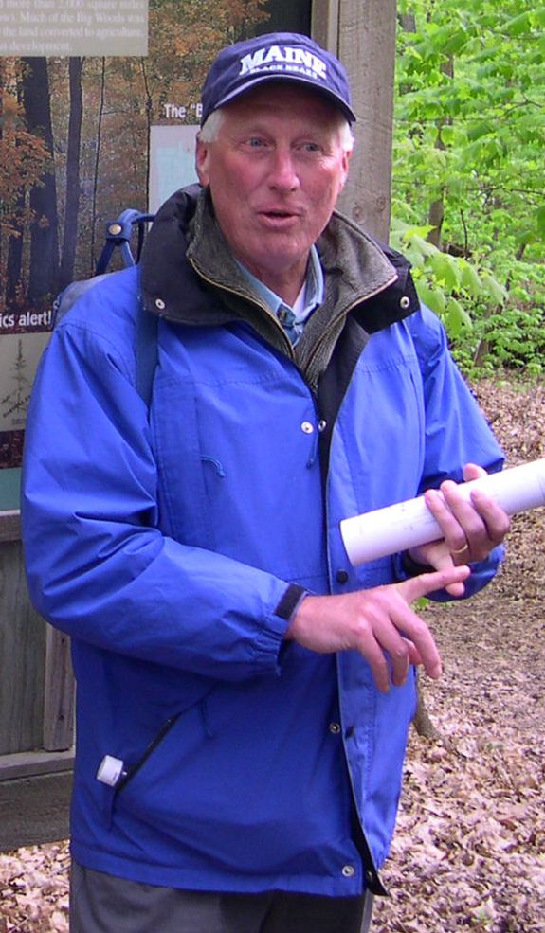
George L. Jacobson Jr.
He was the chair of the Advisory Board for the newly formed NOAA Paleoecology Program, and strongly encouraged them to fund pollen databases, especially as COHMAP was coming to an end.
In 1988-1989, while on sabbatical leave in Lund, he promoted the idea, along with Björn Berglund, for a European pollen database.
He and Berglund formed a committee to organize a meeting to establish a pollen database for Europe.

Slide 21
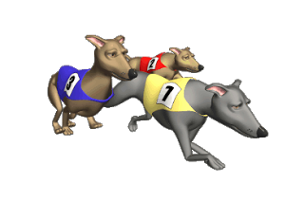
A Short History of Pollen Databases
1970s and 1980s: COHMAP database at Brown University of pollen count data.
Late 1970s: Huntley & Birks database at Cambridge of pollen percentage data.
Late 1980s: Relational Database Management systems available for PCs, and…
1988-1989: George Jacobson sabbatical in Lund.
1989, May: Planning meeting for an EPD in Sweden (Berglund, Jacobson, Huntley, Guiot, Grimm).
1989, August: EPD Meeting in Frostavallen. Jacques-Louis de Beaulieu, Joel Guiot, and Armand Pons proposed to host the database in France.
1990, August: Funding for NAPD received from the NOAA Paleoclimatology Program.
1990, September: EPD meeting in Wilhelmshaven. French team announced that they had received funding.
1991, January: EPD meeting in Arles. Database structure finalized.
1992, April: EPD meeting and software training course in Arles.
1994, March: EPD meeting and software training in Arles.
1994: Master NAPD tables moved from the ISM to WDC/NGDC in Boulder.
1994: LAPD established. Workshop in Springfield in November. POA Database established.
1995, May: “Workshop Towards Establishing a Quaternary Pollen Database for China” in Beijing.
1995: Pollen Database for Siberia and Russian Far East established. Workshop in Seattle in October.
1996, February: EPD workshop in Krakow. An agreement, in principle, to merge data into a GPD.
1996: APD established.
1999: GPD workshop in Boulder.
2001, April: GPD workshop at Løvenholm Castle in Denmark.
2002: GPD meeting in Casablanca.

Slide 22
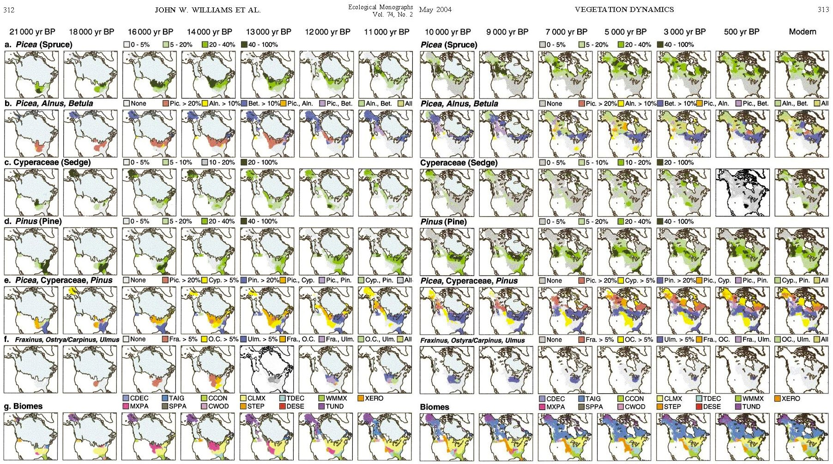
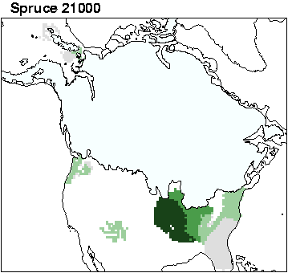
The pollen databases have facilitated a great amount of new research. Hundreds of papers from peer reviewed journals have used data from them
Williams, J.W., B.N. Shuman, T. Webb III, P.J. Bartlein, and P.L. Leduc. 2004. Late-Quaternary vegetation dynamics in North America: scaling from taxa to biomes. Ecological Monographs 74(2):309-334.

Slide 23
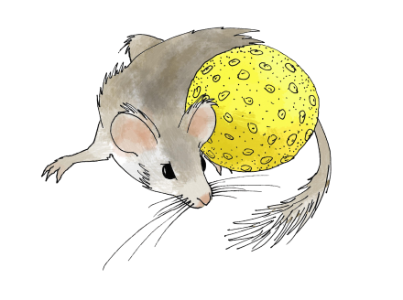
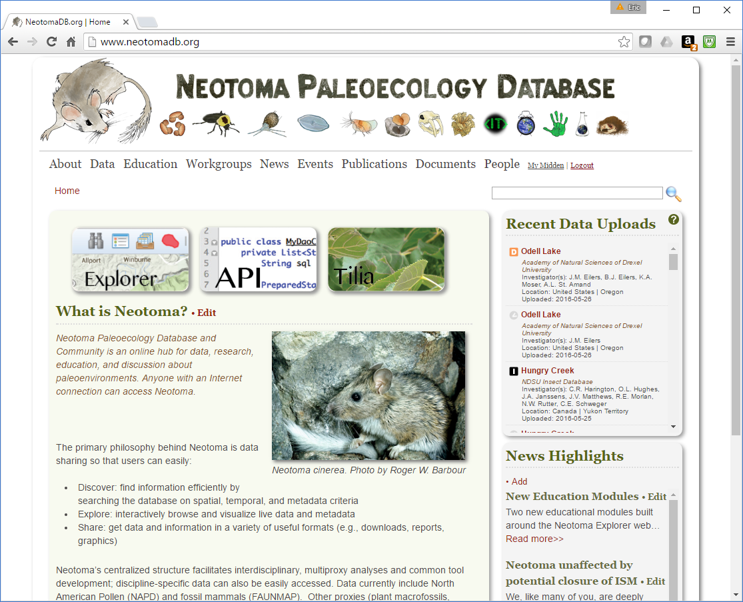
NEOTOMA Paleoecology Database
www.neotomadb.org
Pollen databases became essential cyberinfrastructure for global change research.
Databases existed for other paleo data: plant macrofossils, vertebrate fauna, diatoms, ostracodes,…
Wouldn’t it be great to integrate our pollen data with these other data?
YES!
To this end, a workshop was held at Pennsylvania State University in February 2007 to form a “Late Neogene Ecosystem Database,” which begat the Neotoma Paleoecology Database.

Slide 24
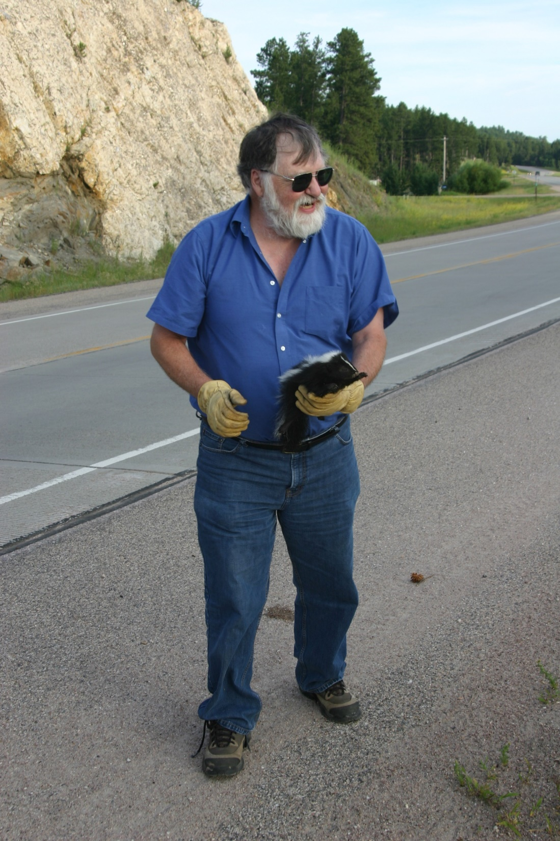
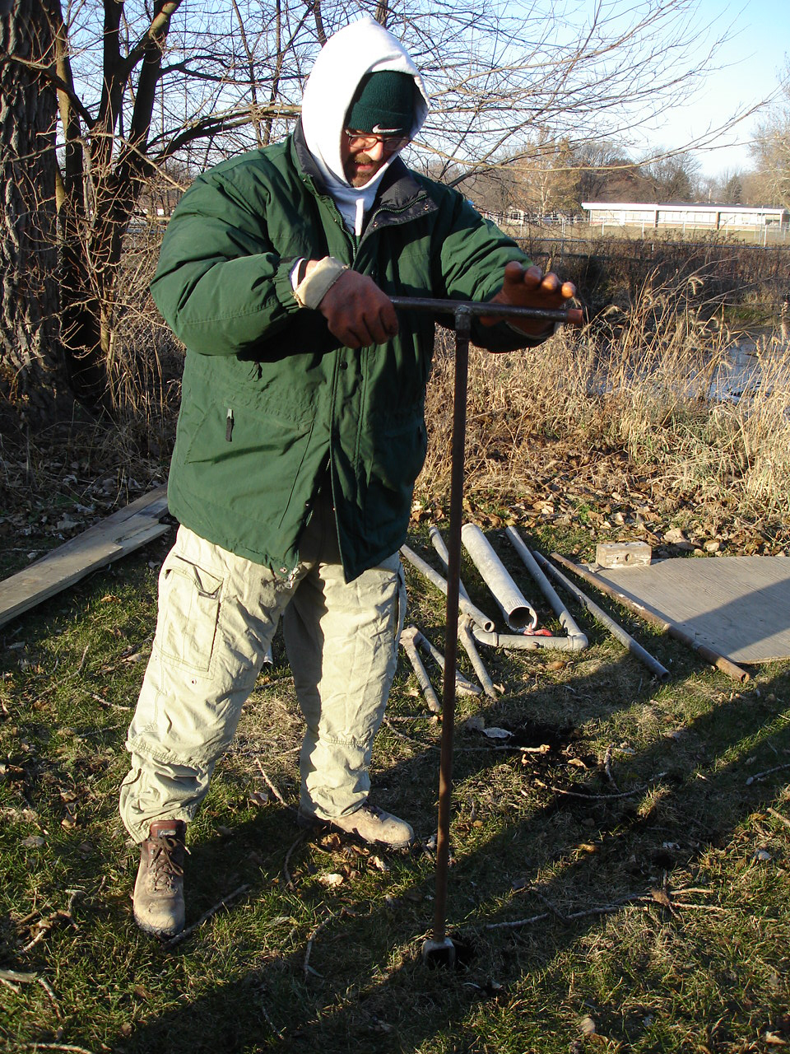
Russ Graham
Brandon Curry

Slide 25
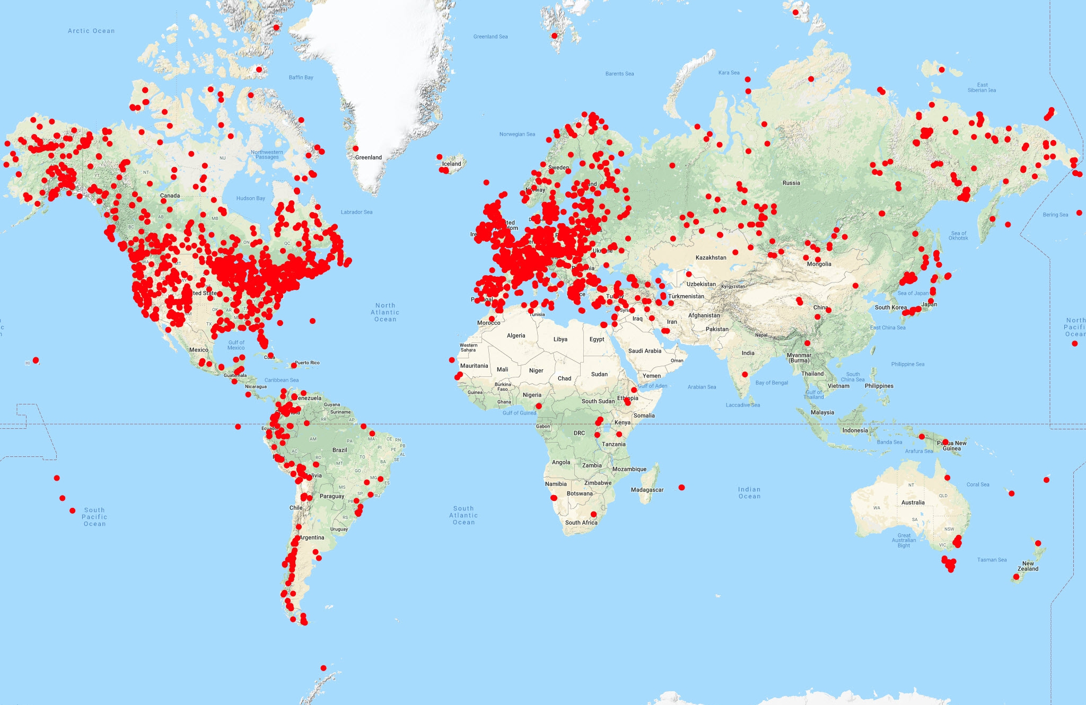
NEOTOMA: Pollen Datasets
Pollen: 3596 sites, 4307 datasets
Total: >36,000 datasets

Slide 26
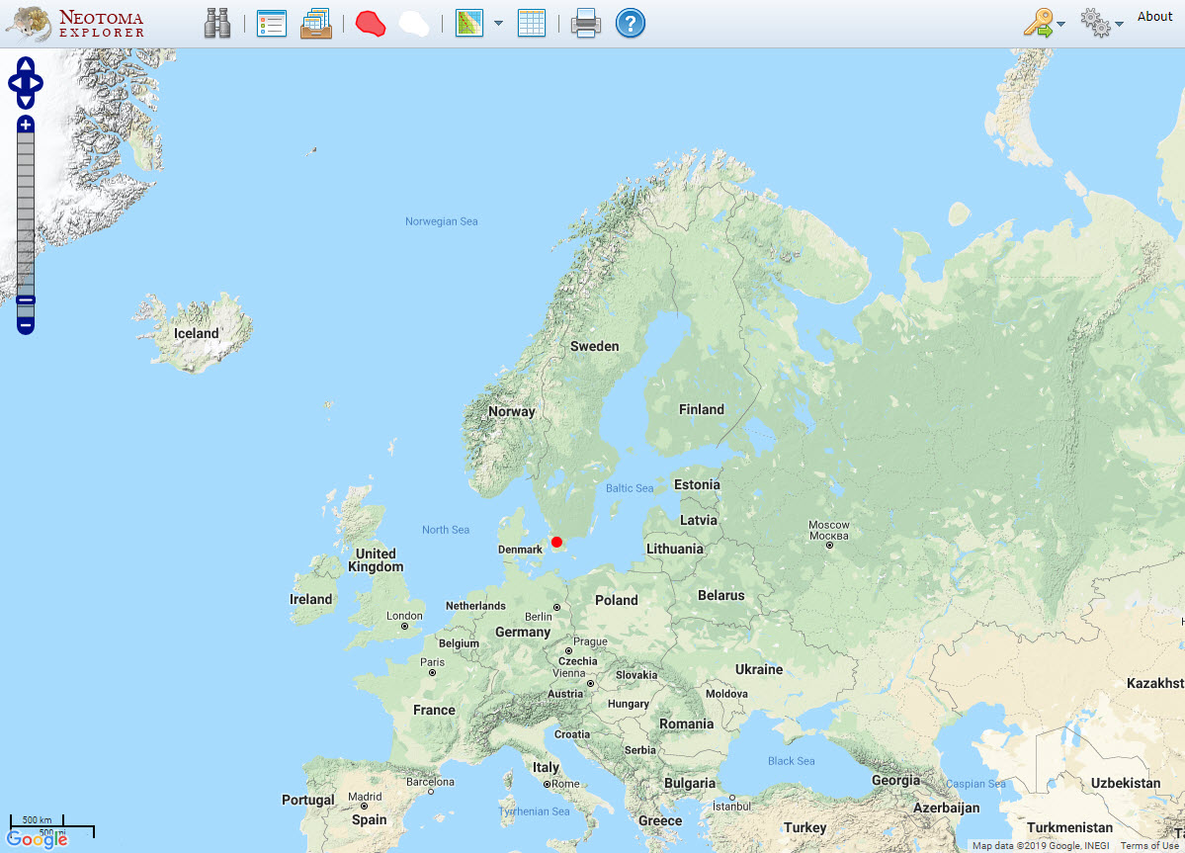
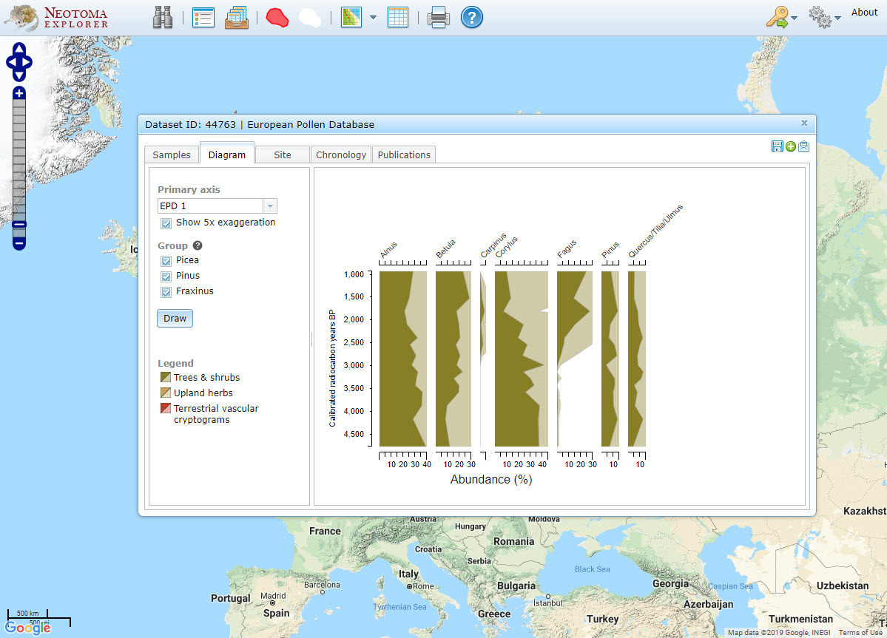
NEOTOMA Explorer
Rönneholms mosse (von Post 1918)

Slide 27

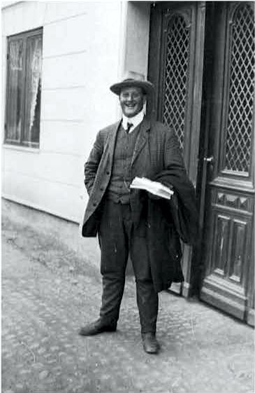

Thank you Lennert von Post!

